Slide 1
CANVA
About
Launched in 2013, Canva is an online design and publishing ...

Slide 2

WHAT IS CANVA?
Canva is an online template editor app for creating social media graphics and presentations.

Slide 3
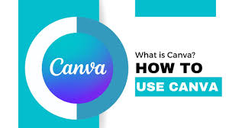
How to use Canva?
5 Smart Ways to Use Canva ...
Canva is an easy-to-use, free graphic design software that ...

Slide 4
Education Purpose
What is Canva used for students?
Canva for Education features Student presentations and projects instantly become more exciting when created through Canva, with students receiving access to over 60,000 templates across posters, notepads, and infographics, as well as millions of images, thousands of font types and over 800,000 illustrations and icons.

Slide 5
Canva Tutorial
Canva is a cloud-based graphic design tool used to create on-brand marketing content, sales presentations, training videos and more by companies of all ...
Easy to Learn and Use: Canva was designed for absolute beginners in the graphic design world. There are many tutorials and lessons available on the platform
Canva is an online template editor app for creating social media graphics and programs.
Canva is a graphic design program, which is distinct from drawing programs like Procreate. This means that you can't draw in Canva .

Slide 6
https://adventureswithart.com/what-is-canva-good-for-10-reasons-to-use-it-for-design/
https://www.google.com/search?sca_esv=515e485ef43ad46e&rlz=1C1GCEU_enPK1089PK1089&q=what+is+canva&uds=AMwkrPuIpADS0H7tmfPDmpB6vrsFPX4iDJ1BACzaHqCriFQy6wMjBtIugayz_lPW

